Slide 1

Building A Heart Beat Detection And Monitoring System Using Arduino
IOT MINI PROJECT

Slide 2

MOIN AHMED KHAN 20181CSE0863
TANNU GIRI 20181CSE0847
N MOHAMMED NAWAZ 20181CSE0853
JUVERIA ANJUM 20181CSE0860
ARCHIT KUMAR 20181CSE0856

Slide 3
Table of Contents:
Introduction
2. Problem Statement
Components Required
Software
Architecture
Applications

Slide 4
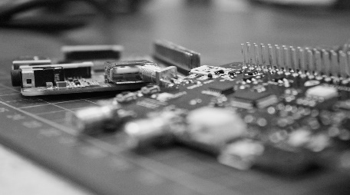
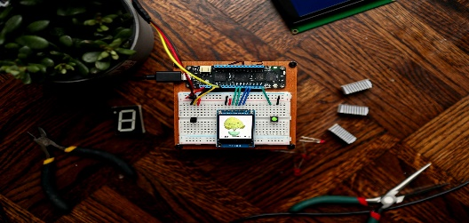
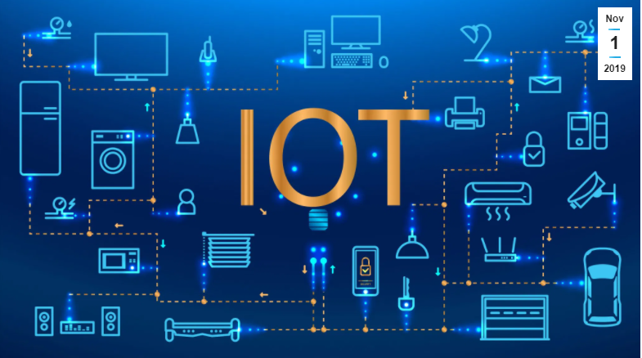


INTRODUCTION TO IOT
What is IOT?
The Internet of Things, or IOT , is a scalable and automated solution that has seen explosive growth in other industries such as automated manufacturing, wearable consumer electronics, and asset management IOT consists of several functional components: data collection, transfer, analytics, and storage.

Slide 5

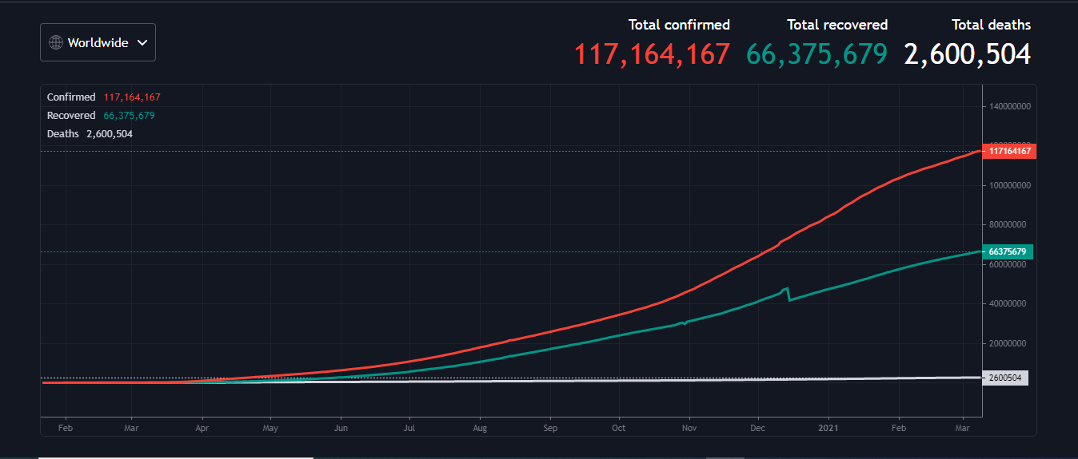
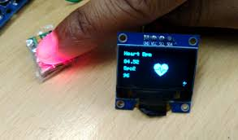

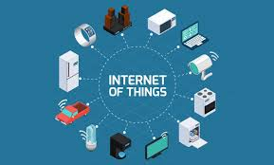
PROBLEM STATEMENT
The current global challenge of COVID-19 pandemic has surpassed the provincial radical , conceptual, spiritual , social and pedagogical boundaries
Internet Of Things (IOT) enabled healthcare system is useful for proper monitoring of COVID-19 patients , by employing an interconnected network
This technology helps to increase patient satisfaction and reduces readmission rate in hospital.

Slide 6
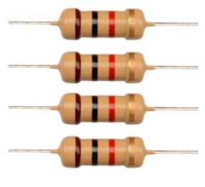
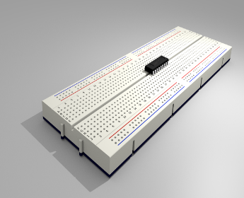
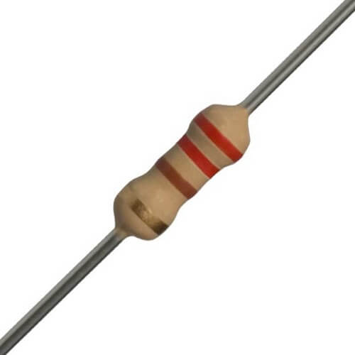
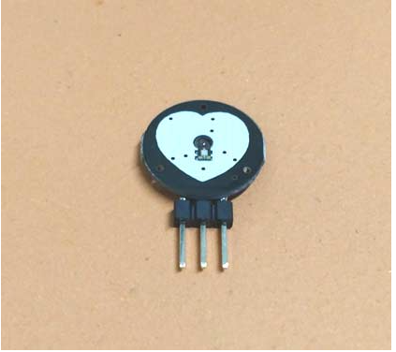
COMPONENTS REQUIRED
1k resistors
A resistor reduces (or resists) the flow of current1k Ω resistor has a value of 1,000 ohms and the number we will code is 1,000.
A breadboard, or protoboard, is a construction base for prototyping of electronics.The purpose of the breadboard is to make quick electrical connections between components
Bread Board
220 ohm resistors
220 ohm 1/4 watt Resistor (Pack of 10)Resistors act to reduce current flow, and, at the same time, act to lower voltage levels within circuits.
Pulse Sensor is a well-designed plug-and-play heart-rate sensor for Arduino. The sensor clips onto a fingertip or earlobe and plugs right into Arduino with some jumper cables. It also includes an open-source monitoring app that graphs your pulse in real time.
Pulse sensor

Slide 7
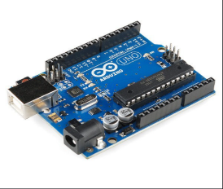
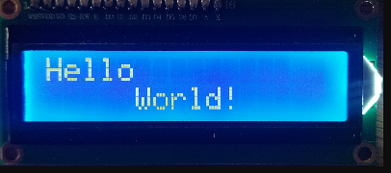
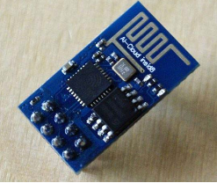
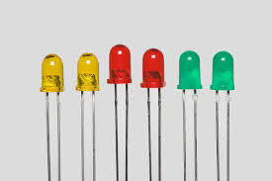
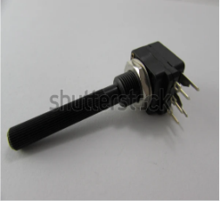
Arduino
Uno
Arduino is an open-source electronics platform based on easy-to-use hardware and software. Arduino boards are able to read inputs
A liquid-crystal display (LCD) is a flat-panel display or other electronically modulated optical device that uses the light-modulating properties of liquid crystals combined with polarizers. Liquid crystals do not emit light directly, instead using a backlight or reflector to produce images in color or monochrome.
LCD
Wi-Fi module ESP8266
The Wifi module ESP8266 is a low-cost Wi-Fi microchip, with a full TCP/IP stack and microcontroller capability, This small module allows microcontrollers to connect to a Wi-Fi network and make simple TCP/IP connections using Hayes-style commands.
A light-emitting diode (LED) is a semiconductor light source that emits light when current flows through it. Electrons in the semiconductor recombine with electron holes, releasing energy in the form of photons.
LED
10k potentiometer
Potentiometers work by having a resistive element inside. Both end terminals are attached to it, and do not move

Slide 8

ThingSpeakThingSpeak™ is an IoT analytics platform service that allows you to aggregate, visualize and analyze live data streams in the cloud. ThingSpeak provides instant visualizations of data posted by your devices to ThingSpeak. With the ability to execute MATLAB® code in ThingSpeak you can perform online analysis and processing of the data as it comes in. ThingSpeak is often used for prototyping and proof of concept IoT systems that require analytics
software

Slide 9
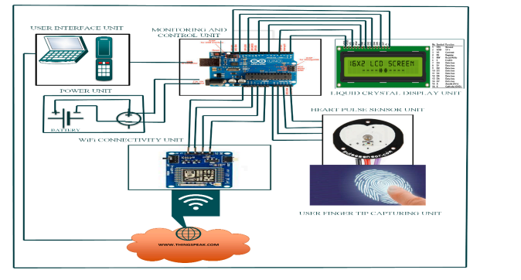
Architecture
Alerts Fitness Monitoring

Slide 10
applications
Digital Heart Rate monitor
Patient monitoring system

